Slide 1
Data Forge – Structure for the Modern Data Enterprise
A framework for extracting value from data assets

Slide 2
ROOTS IN BIG DATA
V
V
V
V
V
Volume
Velocity
Variety
Veracity
Value
These 2 Vs are often overlooked

Slide 3
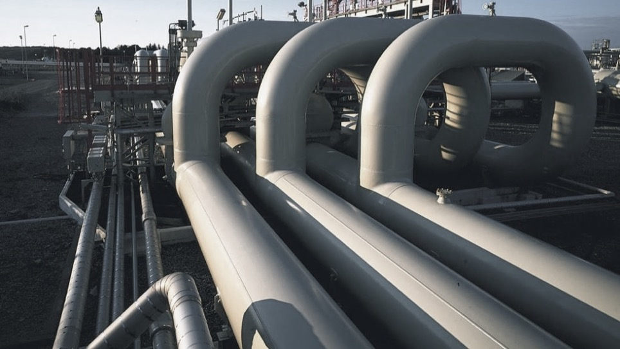

Building a Modern Data Pipeline
Ingest: Capture the data from the source (especially for ephemeral sources)
Model: Handle differences in input format for common data sets
Enhance: Add additional context, make each data record more usable
Transform: Combine and aggregate data sets to produce new data products that are ready for consumption
Deliver: Retrieve and send data sets / records to support data based applications and analytics

Slide 4
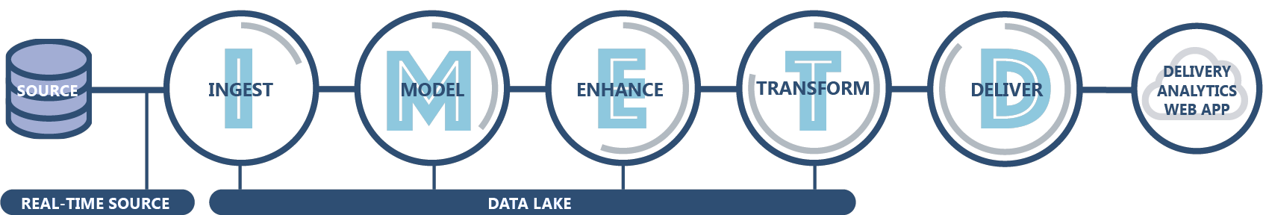



DataForge: Modern Data Platform
A well structured and maintained data lake supports and integrates better with enabling technologies and implemented use cases
Structure
Formats
ENABLING TECHNOLOGIES
Data Catalog
Lineage Tracker
Notifications / Logging
Validation Engine
Technology
Directory Service Integration
Data Provisioning
Infrastructure as Code
Data Platform Analytics
ENABLING CAPABILITIES
Maintenance and Operations
Data Governance
Experimentation
Data Product Development
People
Process
OUTCOMES
Visibility
Data Quality
Security
Return on Investment
Agility
Compliance

Slide 5

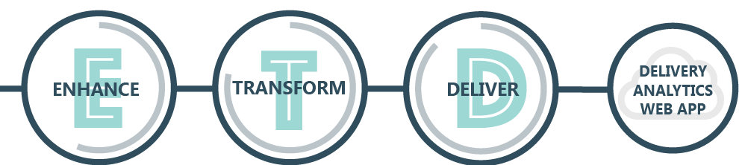
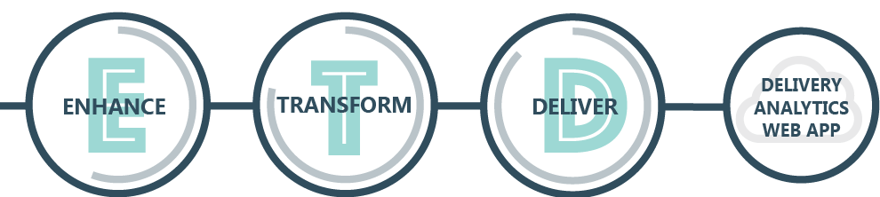
Data Forge: Experiment to Show Value
Raw data is ingested and modeled into your data lake to enable experimentation
DATA LAKE
Data Lab Experimentation Platform
Prototypes
Identified opportunities are vetted in the experimentation platform
The experimentation platform often uses a different set of technology enable rapid iteration
Prototypes make experimental results easy to understand

Slide 6
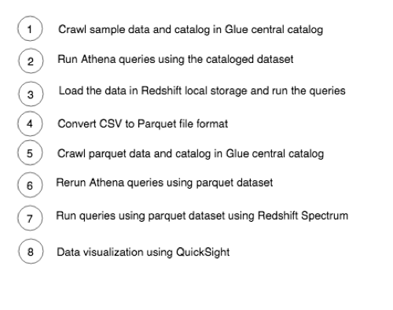
DataForge: Modern Data Platform on AWS – lab

Slide 7

Amazon S3—Object Storage
Secure, highly scalable, durable object storage with millisecond latency for data access
Store any type of data–web sites, mobile apps, corporate applications, and IoT sensors
Durability, Availability & Scalability
Security and Compliance
Query in Place
Flexible Management
Built for eleven nine’s of durability; data distributed across 3 physical facilities in an AWS region; automatically replicated to any other AWS region
Three different forms of encryption; encrypts data in transit when replicating across regions; log and monitor with CloudTrail, use ML to discover and protect sensitive data with Macie
Run analytics & ML on data lake without data movement; S3 Select can retrieve subset of data, improving analytics performance by 400%
Classify, report, and visualize data usage trends; objects can be tagged to see storage consumption, cost, and security; build lifecycle policies to automate tiering, and retention

Slide 8

AWS Glue—Data Catalog Make data discoverable
Glue Data Catalog
Automatically discovers data and stores schema
Catalog makes data searchable, and available for ETL
Catalog contains table and job definitions
Computes statistics to make queries efficient
Discover data and extract schema
Compliance

Slide 9
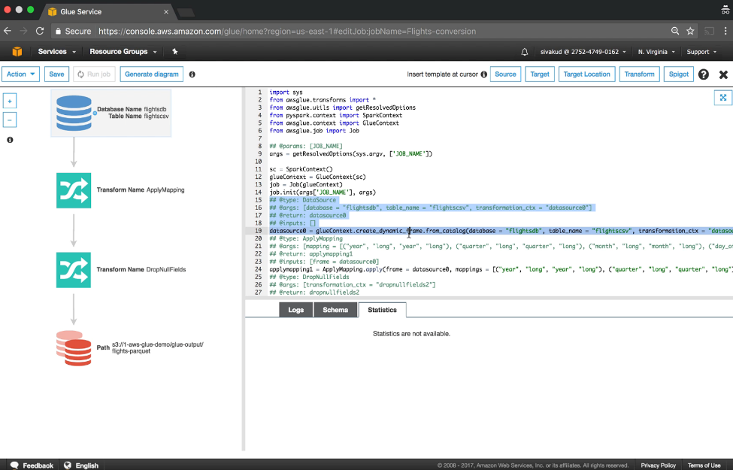
AWS Glue—ETL Service Make ETL scripting and deployment easy
Automatically generates ETL code
Code is customizable with Python and Spark
Endpoints provided to edit, debug, test code
Jobs are scheduled or event-based
Serverless

Slide 10

Amazon Athena—Interactive Analysis
Interactive query service to analyze data in Amazon S3 using standard SQL
No infrastructure to set up or manage and no data to load
Ability to run SQL queries on data archived in Amazon Glacier (coming soon)
Query Instantly
Pay per query
Open
Easy
$
SQL
Zero setup cost; just point to S3 and start querying
Pay only for queries run; save 30–90% on per-query costs through compression
ANSI SQL interface, JDBC/ODBC drivers, multiple formats, compression types, and complex joins and data types
Serverless: zero infrastructure, zero administration
Integrated with QuickSight

Slide 11


Amazon QuickSight
Fast, easy to use, serverless analytics at 1/10 the cost of traditional BI
Empower
everyone
Seamless connectivity
Fast analysis
Serverless

